Slide 1
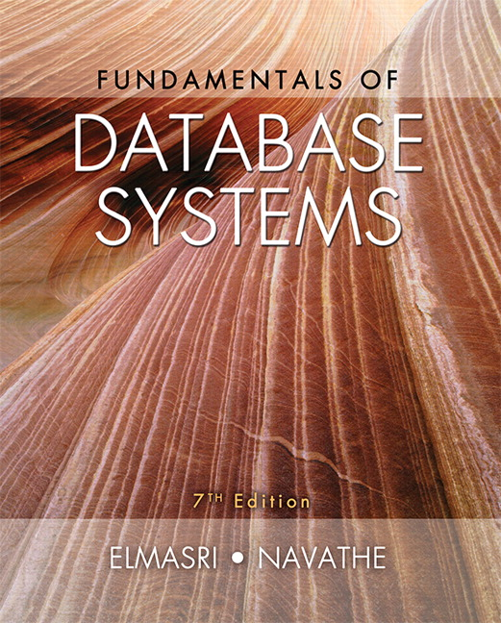

Slide 2
CHAPTER 21
Concurrency Control Techniques

Slide 3
Introduction
Concurrency control protocols
Set of rules to guarantee serializability
Two-phase locking protocols
Lock data items to prevent concurrent access
Timestamp
Unique identifier for each transaction

Slide 4
21.1 Two-Phase Locking Techniques for Concurrency Control
Lock
Variable associated with a data item describing status for operations that can be applied
One lock for each item in the database
Binary locks
Two states (values)
Locked (1)
Item cannot be accessed
Unlocked (0)
Item can be accessed when requested

Slide 5
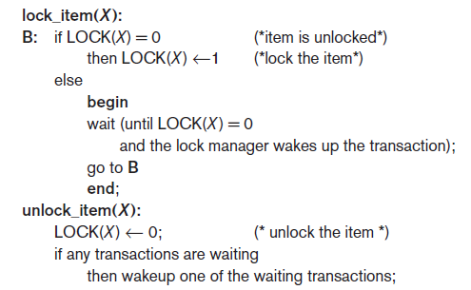
Two-Phase Locking Techniques for Concurrency Control (cont’d.)
Transaction requests access by issuing a lock_item(X) operation

Slide 6
Two-Phase Locking Techniques for Concurrency Control (cont’d.)
Lock table specifies items that have locks
Lock manager subsystem
Keeps track of and controls access to locks
Rules enforced by lock manager module
At most one transaction can hold the lock on an item at a given time
Binary locking too restrictive for database items

Slide 7
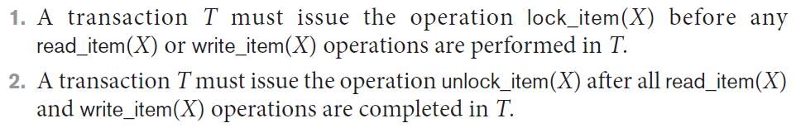
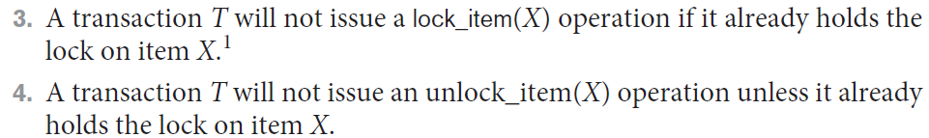
Two-Phase Locking Techniques for Concurrency Control (cont’d.)
If the simple binary locking scheme described is used, then every transaction must obey the following rules:

Slide 8
Two-Phase Locking Techniques for Concurrency Control (cont’d.)
Shared/exclusive or read/write locks or multi-mode locks
Read operations on the same item are not conflicting
Must have exclusive lock to write
Three locking operations
read_lock(X)
write_lock(X)
unlock(X)

Slide 9
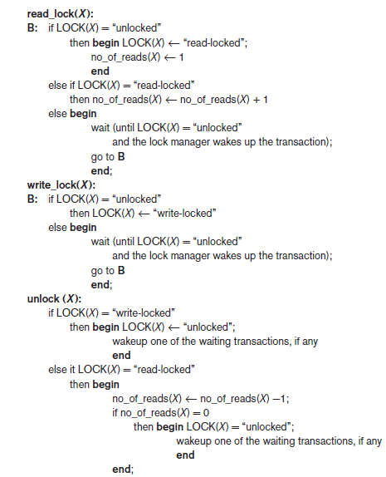
Figure 21.2 Locking and unlocking operations for two-mode (read/write, or shared/exclusive) locks

Slide 10
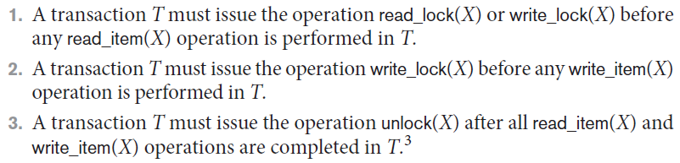
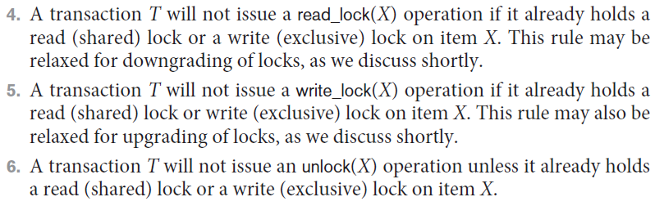
Two-Phase Locking Techniques for Concurrency Control (cont’d.)
When we use the shared/exclusive locking scheme, the system must enforce the following rules:

Slide 11
Two-Phase Locking Techniques for Concurrency Control (cont’d.)
Lock conversion
Transaction that already holds a lock allowed to convert the lock from one state to another
Upgrading
Issue a read_lock operation then a write_lock operation
Downgrading
Issue a read_lock operation after a write_lock operation

Slide 12
Using binary locks or read/write locks in transactions, as described earlier, does not guarantee serializability of schedules on its own.
Take an example in the next slide:

Slide 13
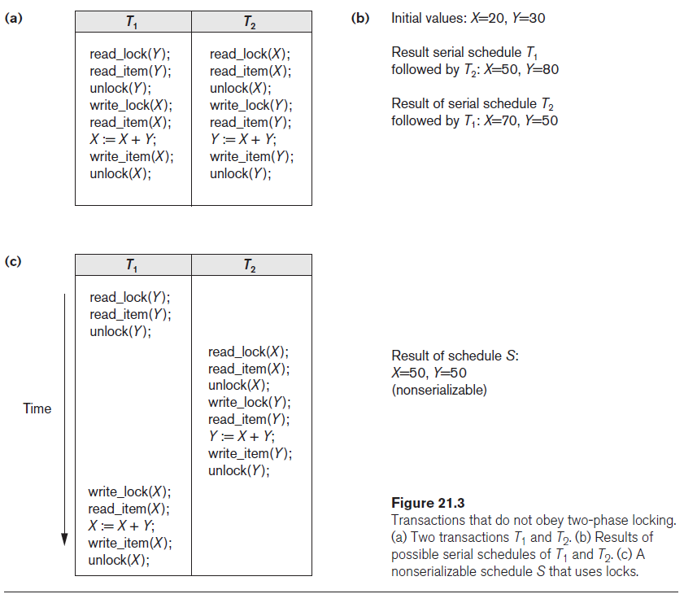

Slide 14
Guaranteeing Serializability by Two-Phase Locking (2PL)
Two-phase locking protocol
All locking operations precede the first unlock operation in the transaction
Phases
Expanding (growing) phase
New locks can be acquired but none can be released
Lock conversion upgrades (from read-locked to write-locked) must be done during this phase
Shrinking phase
Existing locks can be released but none can be acquired
Downgrades (from write-locked to read-locked) must be done during this phase

Slide 15
Guaranteeing Serializability by Two-Phase Locking (2PL)
If every transaction in a schedule follows the two-phase locking protocol, schedule guaranteed to be serializable
Two-phase locking may limit the amount of concurrency that can occur in a schedule
Some serializable schedules will be prohibited by two-phase locking protocol

Slide 16
Variations of Two-Phase Locking (2PL)
Basic 2PL
Technique described on previous slides
Conservative (static) 2PL
Requires a transaction to lock all the items it accesses before the transaction begins
Predeclare read-set and write-set
Deadlock-free protocol
difficult to use in practice because of the need to predeclare the read-set and write-set, which is not possible in some situations.
Strict 2PL
Transaction does not release exclusive locks (write locks) until after it commits or aborts. It is not deadlock-free.

Slide 17
Variations of Two-Phase Locking (cont’d.)
Rigorous 2PL
Transaction does not release any locks (exclusive or shared) until after it commits or aborts
Concurrency control subsystem responsible for generating read_lock and write_lock requests
Locking generally considered to have high overhead
because every read or write operation is preceded by a system locking request

Slide 18
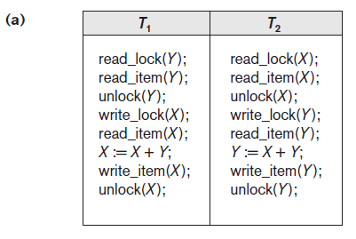

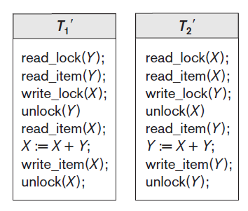
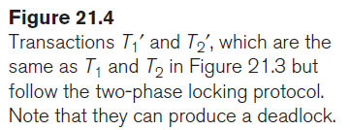

Slide 19
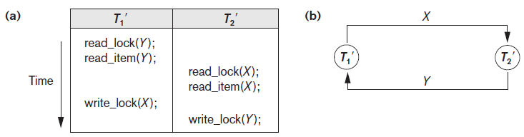
Dealing with Deadlock and Starvation
Deadlock
Occurs when each transaction T in a set is waiting for some item locked by some other transaction T’
Both transactions stuck in a waiting queue
Figure 21.5 Illustrating the deadlock problem (a) A partial schedule of T1′ and T2′ that is
in a state of deadlock (b) A wait-for graph (WFG) for the partial schedule in (a)

Slide 20
Dealing with Deadlock and Starvation (cont’d.)
Deadlock prevention protocols
Every transaction locks all items it needs in advance
Ordering all items in the database
Transaction that needs several items will lock them in that order
Both approaches impractical

Slide 21
Dealing with Deadlock and Starvation (cont’d.)
A number of other deadlock prevention schemes have been proposed that make a decision about what to do with a transaction involved in a possible deadlock situation:
these techniques use the concept of transaction timestamp TS(T′), which is a unique identifier assigned to each transaction.
if transaction T₁ starts before transaction T₂,
then TS(T₁) < TS(T₂).
NOTE: older transaction (which starts first) has the smaller timestamp value

Slide 22
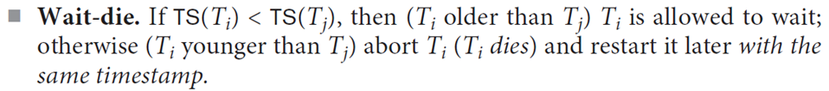
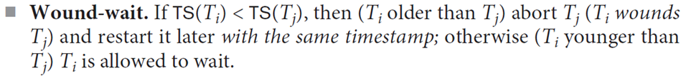
Dealing with Deadlock and Starvation (cont’d.)
2 Protocols based on a timestamp
Suppose that transaction T_{i} tries to lock an item X but is not able to because X is locked by some other transaction T_{j}
since in wait-die, transactions only wait for younger transactions so no cycle is created.
In wound-wait, transactions only wait for older transactions so no cycle is created.

Slide 23
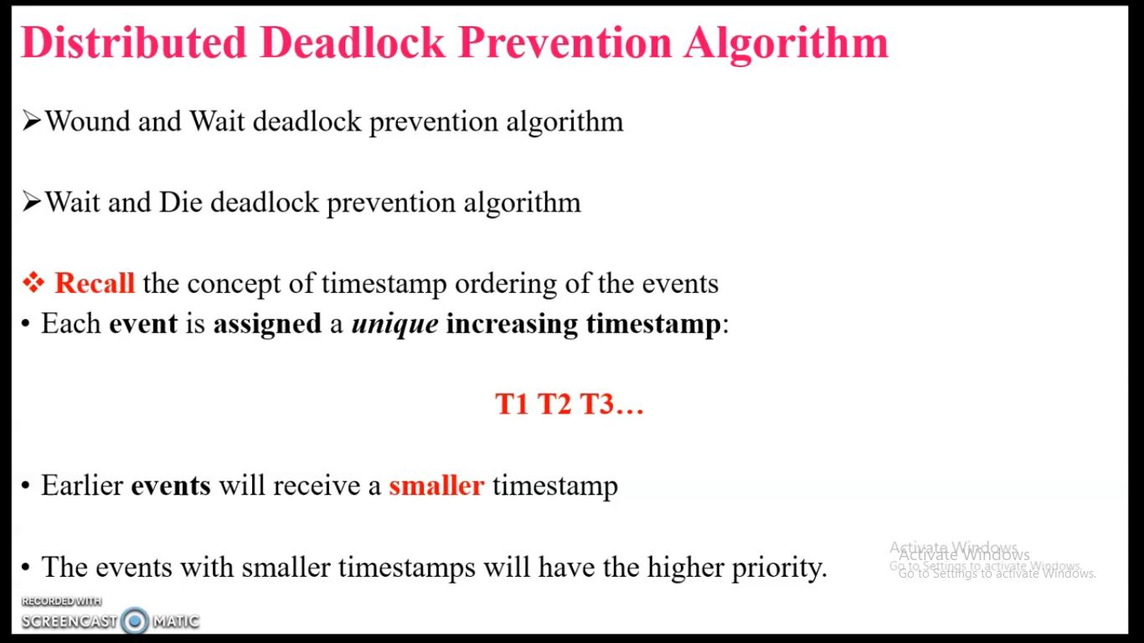

Slide 24
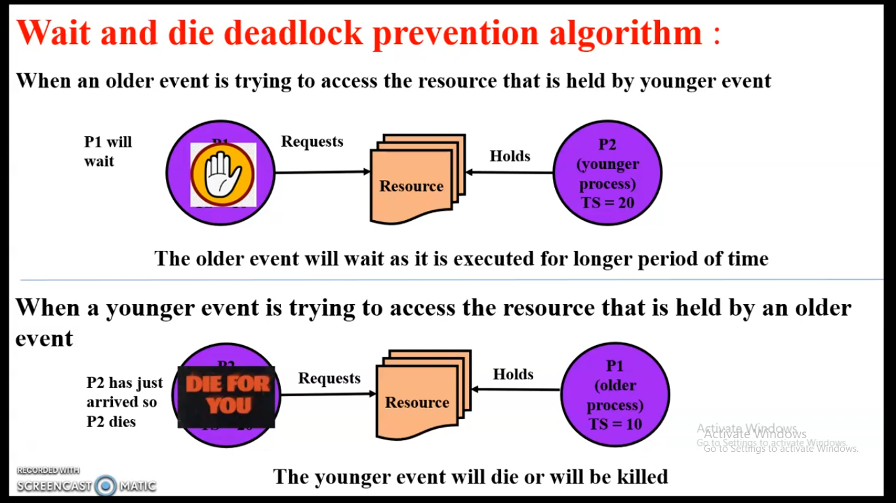

Slide 25
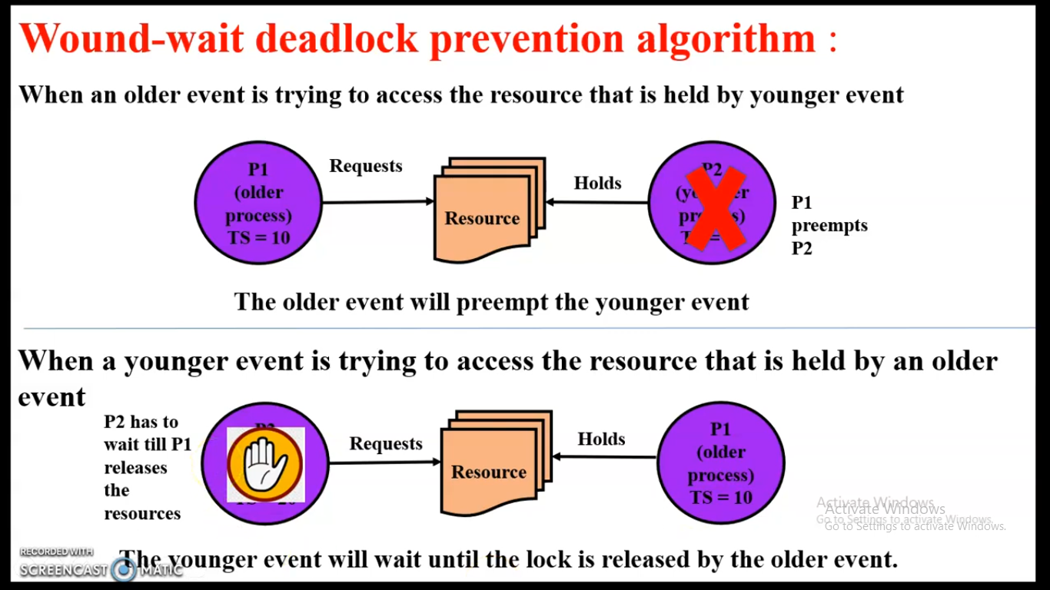

Slide 26
Dealing with Deadlock and Starvation (cont’d.)
No waiting algorithm
If transaction unable to obtain a lock, immediately aborted and restarted later
Cautious waiting algorithm
Deadlock detection
System checks to see if a state of deadlock exists
Wait-for graph (a state of deadlock if and only if the wait-for graph has a cycle)

Slide 27
Dealing with Deadlock and Starvation (cont’d.)
Victim selection
Deciding which transaction to abort in case of deadlock (avoid selecting transactions that have been running for a long time)
Timeouts
If system waits longer than a predefined time, it aborts the transaction
Starvation
Occurs if a transaction cannot proceed for an indefinite period of time while other transactions continue normally
Solution: first-come-first-served queue

Slide 28
21.2 Concurrency Control Based on Timestamp Ordering
Timestamp
Unique identifier assigned by the DBMS to identify a transaction
Assigned in the order submitted
Transaction start time
Concurrency control techniques based on timestamps do not use locks, so
Deadlocks cannot occur

Slide 29
Concurrency Control Based on Timestamp Ordering (cont’d.)
Generating timestamps
Counter incremented each time its value is assigned to a transaction
Current date/time value of the system clock
Ensure no two timestamps are generated during the same tick of the clock
General approach
Enforce equivalent serial order on the transactions based on their timestamps

Slide 30
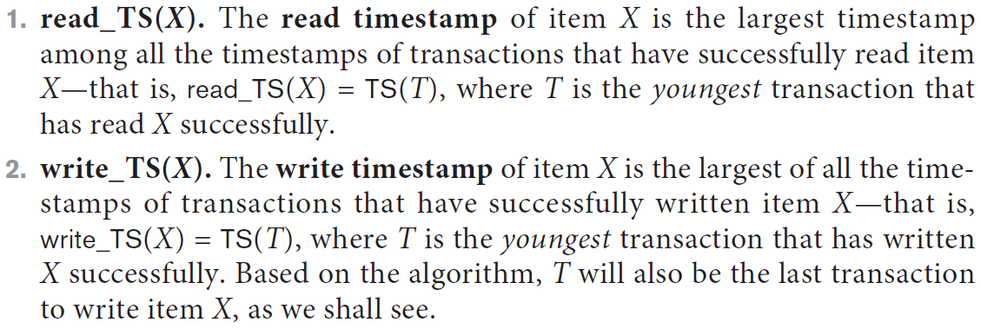
Concurrency Control Based on Timestamp Ordering (cont’d.)
Timestamp ordering (TO)
Allows interleaving of transaction operations
Must ensure timestamp order is followed for each pair of conflicting operations
Each database item assigned two timestamp values 1) read_TS(X) and 2) write_TS(X)

Slide 31
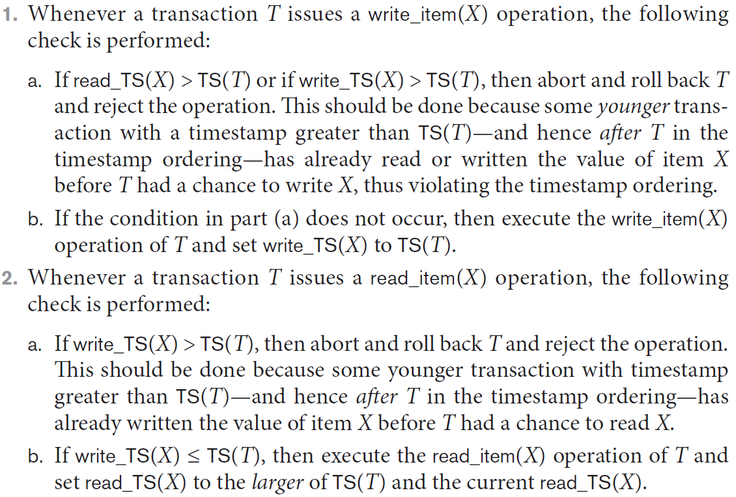
Concurrency Control Based on Timestamp Ordering (cont’d.)
Basic TO algorithm
Starvation may occur

Slide 32
Concurrency Control Based on Timestamp Ordering (cont’d.)
Strict TO algorithm
Ensures schedules are both strict and conflict serializable

Slide 33
Concurrency Control Based on Timestamp Ordering (cont’d.)
Thomas’s write rule
Modification of basic TO algorithm
Does not enforce conflict serializability
Rejects fewer write operations by modifying checks for write_item(X) operation

Slide 34
21.3 Multiversion Concurrency Control Techniques
Several versions of an item are kept by a system
Some read operations that would be rejected in other techniques can be accepted by reading an older version of the item
Maintains serializability
More storage is needed
Multiversion currency control scheme types
Based on timestamp ordering
Based on two-phase locking
Validation and snapshot isolation techniques

Slide 35
Multiversion Concurrency Control Techniques (cont’d.)
Multiversion technique based on timestamp ordering
Two timestamps associated with each version are kept
read_TS(X_{i})
write_TS(X_{i})

Slide 36
Multiversion Concurrency Control Techniques (cont’d.)

Slide 37
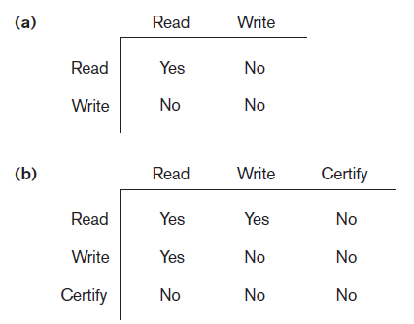
Multiversion Concurrency Control Techniques (cont’d.)
Multiversion two-phase locking using certify locks
Three locking modes: read, write, and certify
Figure 21.6 Lock compatibility tables (a) Lock compatibility table for read/write locking scheme (b) Lock compatibility table for read/write/certify locking scheme

Slide 38
21.4 Validation (Optimistic) Techniques and Snapshot Isolation Concurrency Control
Optimistic techniques
Also called validation or certification techniques
No checking is done while the transaction is executing
Updates not applied directly to the database until finished transaction is validated
All updates applied to local copies of data items
Validation phase checks whether any of transaction’s updates violate serializability
Transaction committed or aborted based on result

Slide 39
Concurrency Control Based on Snapshot Isolation
Transaction sees data items based on committed values of the items in the database snapshot
Does not see updates that occur after transaction starts
Read operations do not require read locks
Write operations require write locks
Temporary version store keeps track of older versions of updated items
Variation: serializable snapshot isolation (SSI)

Slide 40
21.5 Granularity of Data Items and Multiple Granularity Locking
Size of data items known as granularity
Fine (small)
Coarse (large)
Larger the data item size, lower the degree of concurrency permitted
Example: entire disk block locked
Smaller the data item size, more locks required
Higher overhead
Best item size depends on transaction type

Slide 41
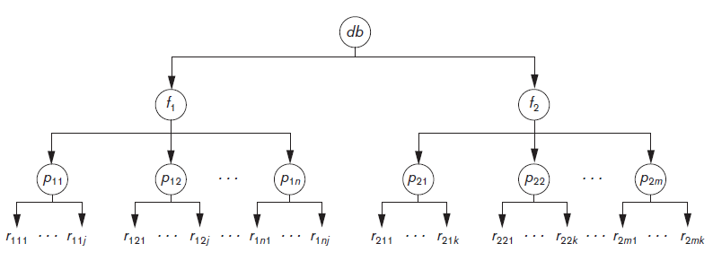
Multiple Granularity Level Locking
Lock can be requested at any level
Figure 21.7 A granularity hierarchy for illustrating multiple granularity level locking

Slide 42
Multiple Granularity Level Locking (cont’d.)
Intention locks are needed
Transaction indicates along the path from the root to the desired node, what type of lock (shared or exclusive) it will require from one of the node’s descendants
Intention lock types
Intention-shared (IS)
Shared locks will be requested on a descendant node
Intention-exclusive (IX)
Exclusive locks will be requested

Slide 43
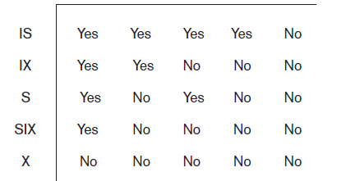
Multiple Granularity Level Locking (cont’d.)
Intention lock types (cont’d.)
Shared-intension-exclusive (SIX)
Current node is locked in shared mode but one or more exclusive locks will be requested on a descendant node
Figure 21.8 Lock compatibility matrix for multiple granularity locking

Slide 44
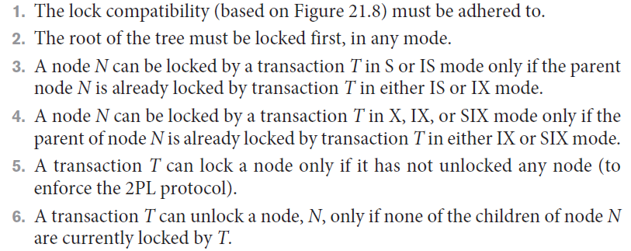
Multiple Granularity Level Locking (cont’d.)
Multiple granularity locking (MGL) protocol rules

